Slide 1
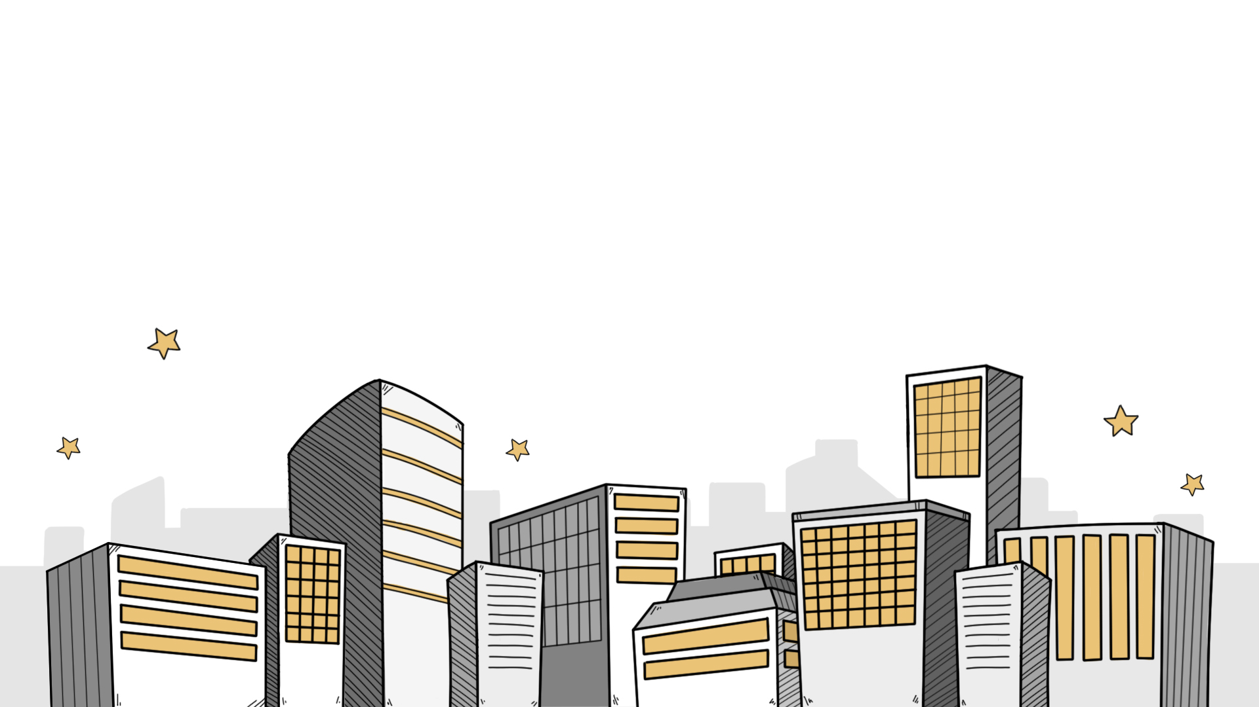
Finding the Optimal Locations for Company Headquarters and Warehouse

Slide 2
Imagine you are the CEO of a company, tasked with finding the perfect locations for your new headquarters and warehouse. This task goes beyond simply picking spots on a map. It involves using mathematical modelling to make informed, strategic decisions that save time and transportation costs.
Consider the scenario in which your headquarters needs to be at the same shortest distance from two key stores. This is a manageable challenge, but it becomes more complicated when you have to consider three or more stores. For the warehouse, the challenge is to position it so that it is equidistant from major roads, optimising transportation routes and delivery times.
In this activity, you will learn to tackle these real-world problems. You will also identify and manage the constraints involved in such decisions. Let’s embark on this quest to find the optimal locations for your company’s headquarters and warehouse!

Slide 3
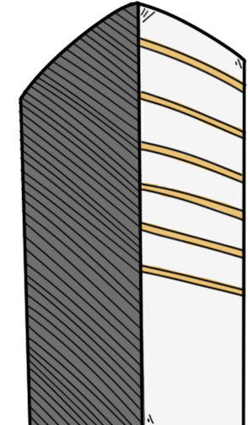
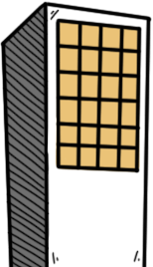
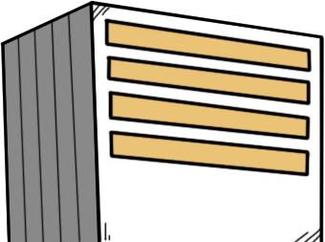
Revision
To recall prior knowledge required in this series of activities

Slide 4
Fill in the blanks with the words provided.
They are four special lines in a triangle.
Perpendicular bisectors
Altitudes
Medians
Angle bisectors
Refer to: https://www.geogebra.org/m/btwzyahk

Slide 5
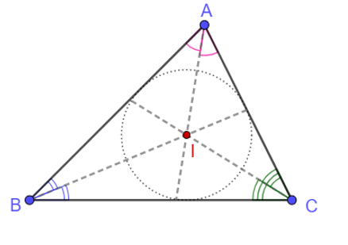
Perpendicular bisectors
Medians
Altitudes
Angle bisectors
1. Incentre I is
the point of intersection of
the three ____________________
in a triangle.
Note: I is the centre of the
largest circle that can be
drawn in the triangle.
The circle drawn is called
the inscribed circle.

Slide 6
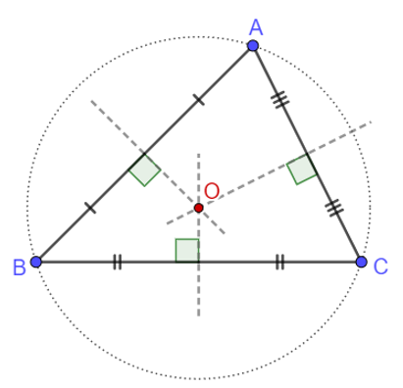
Perpendicular bisectors
Medians
Altitudes
Angle bisectors
2. Circumcentre O is
the point of intersection of
the three ________________
in a triangle.
Note: O is the centre of the
circle which passes through
the three vertices of the triangle.
The circle drawn is called the
circumscribed circle.

Slide 7
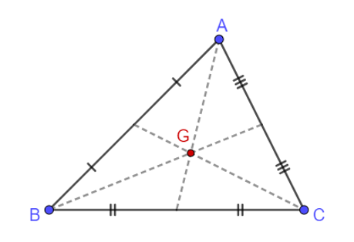
Perpendicular bisectors
Medians
Altitudes
Angle bisectors
3. Centroid G is
the point of intersection of
the three ________________
in a triangle.

Slide 8
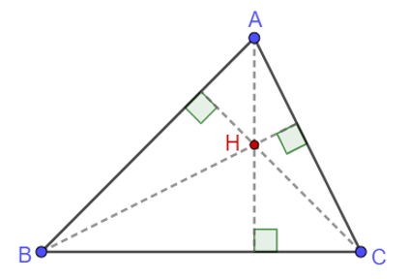
Perpendicular bisectors
Medians
Altitudes
Angle bisectors
4. Orthocentre H is
the point of intersection of
the three ________________
in a triangle.

Slide 9
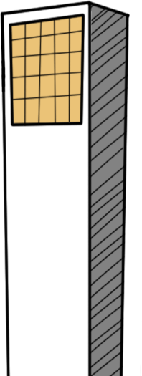
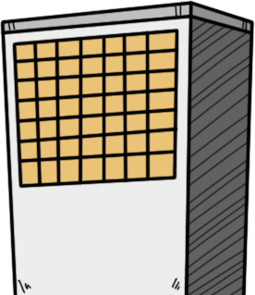
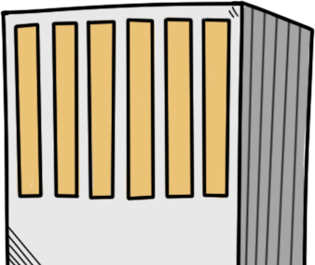
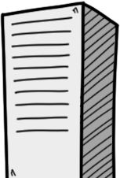
Activity 1A
To ensure the same and shortest distance from the headquarters to two stores.

Slide 10
1. Headquarters Q is the main offices of our company,
from where information is delivered to stores via radio
technology.
If there are two stores A and B, our boss wants to
ensure that the distances between the headquarters
and each of them are the same and the shortest.
Use mathematical terms to describe the requirement.
Q is the mid-point of A and B .

Slide 11
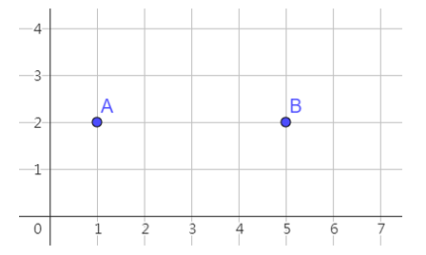
2. The following figures show some specific scenarios.
Points A and B represent the locations of two stores,
respectively.
Mark the optimal locations of the headquarters Q
on the figures and write down their coordinates.
Q
Q = ( 3 , 2 )

Slide 12
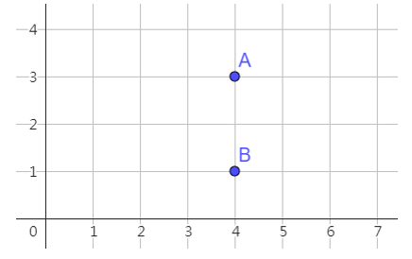
2. The following figures show some specific scenarios.
Points A and B represent the locations of two stores,
respectively.
Mark the optimal locations of the headquarters Q
on the figures and write down their coordinates.
Q
Q = ( 4 , 2 )

Slide 13
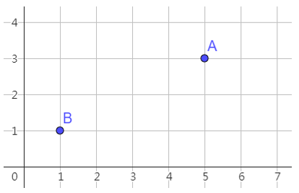
2. The following figures show some specific scenarios.
Points A and B represent the locations of two stores,
respectively.
Mark the optimal locations of the headquarters Q
on the figures and write down their coordinates.
Q
Q = ( 3 , 2 )

Slide 14
3. In reality, store locations vary across different regions.
Let the coordinates of two stores be and ,
respectively.
Write down a model of finding the optimal location for
the headquarters Q .
Answer：

Slide 15
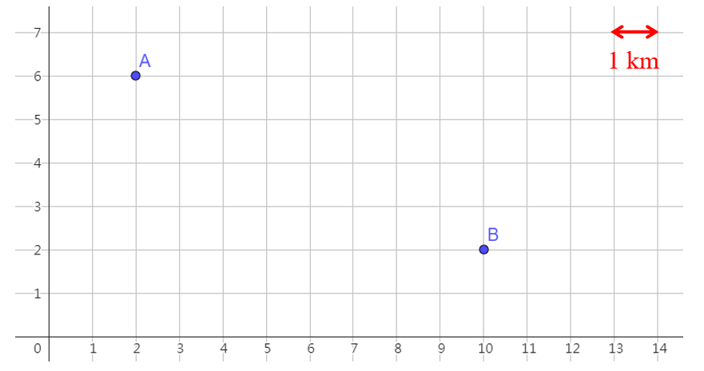
4. In the following figure, points A and B represent the locations of two stores, respectively
(a) Using the model in Question 3, find the coordinates of
the headquarters Q and mark its location on the figure.
(b) Calculate the distance from our headquarters to each
of the stores correct to the nearest 0.01 km.

Slide 16
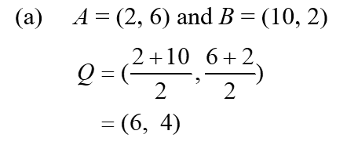
Q
(a) Using the model in
Question 3, find the
coordinates of the
headquarters Q and
mark its location on
the figure.
Answer：

Slide 17
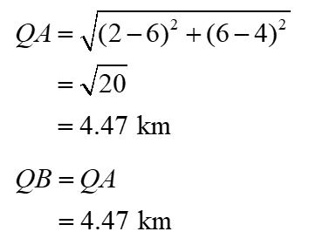
Q
(b) Calculate the distance
from our headquarters
to each of the stores
correct to the nearest
0.01 km.
Answer：

Slide 18
5. What assumptions are made in your model in Question 3?
Unobstructed transmission
2D-model
There are no obstacles
(e.g., hills or buildings)
which block the transmission of the radio wave between the headquarters and the two stores.
Assuming the ground is flat.
In reality, the surface of the Earth is not flat.
If the distances between the headquarters and the two stores are very long, we have to consider the curvature of the Earth’s surface.

Slide 19
6. Apart from the same and shortest distance from the headquarters to our stores, what factors should we consider when finding the optimal location for the headquarters?
Feasibility of construction
Construction costs
The construction of the headquarters at the selected location involves assessing whether the location meets the necessary building regulations and environmental considerations.
The expenses associated with building the headquarters at the selected location include the costs of land acquisition, construction materials, and labour, etc.

Slide 20
Activity 1B
To find the shortest distance between a warehouse and two stores.

Slide 21
7. Warehouse W is a large building for storing and
distributing products to our stores.
Our boss is searching for its best location. There
are two requirements regarding the selected location:
i. To better connect with the rapid transit system,
W must be located beside the distributor road OE.
ii. The total distance between W and our two stores A
and B must be minimised.
Nevertheless, the distances of paths WA and WB
need not be the same.
Explore using the following applet: https://www.geogebra.org/m/a6b9jb2g

Slide 22
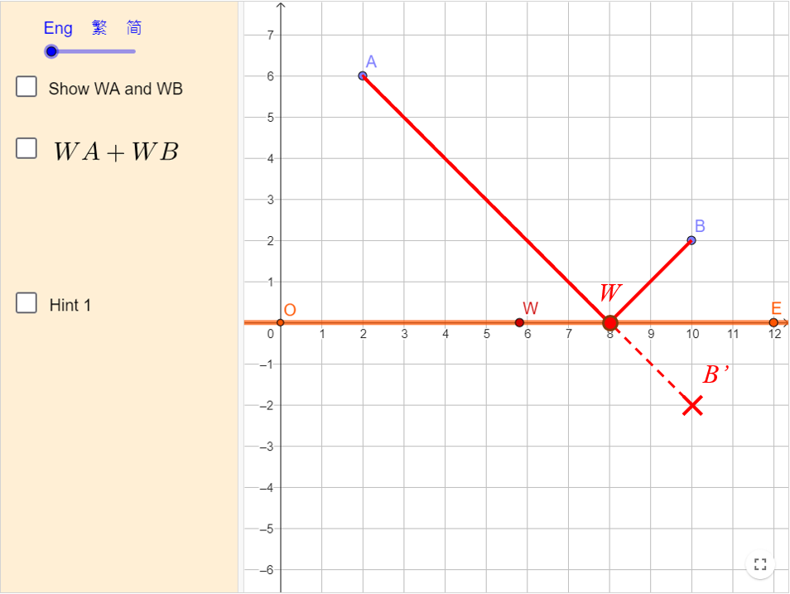
Based on the requirements, WA + WB should be _________________________________.
the smallest (or shortest)

Slide 23
8. Describe how to find the location of the warehouse W.
In the above figure, sketch your steps and mark the
location of W.
First, Point B is reflected about OE, and the image is B’.
Second, we draw a straight line AB’.
Then, the point of intersection of OE and AB’ is the location of the warehouse W.

Slide 24
9. What are some possible constraints when searching for
the location of the warehouse? How can we compromise?
Possible constraints: The construction costs of building the warehouse beside a distributor road may be very high.
In terms of city planning, the area close to a distributor road may be allocated for commercial or residential purposes, rather than industrial purposes.
To remedy the constraints, we can first identify the optimal location of W. Then, we can search for other feasible locations as close to the optimal location as possible.

Slide 25
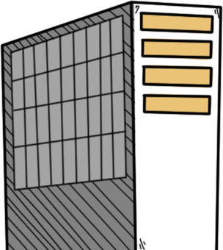
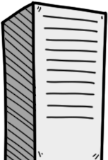
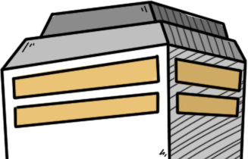
Activity 2A
To ensure the same distance from the headquarters to three stores

Slide 26
1. If there are three different stores A, B and C,
our boss wants to ensure that the distances
between the headquarters Q and each of them
are the same.
Write down the mathematical representation of
this requirement.
QA = QB = QC (or QA, QB and QC are equal.)

Slide 27
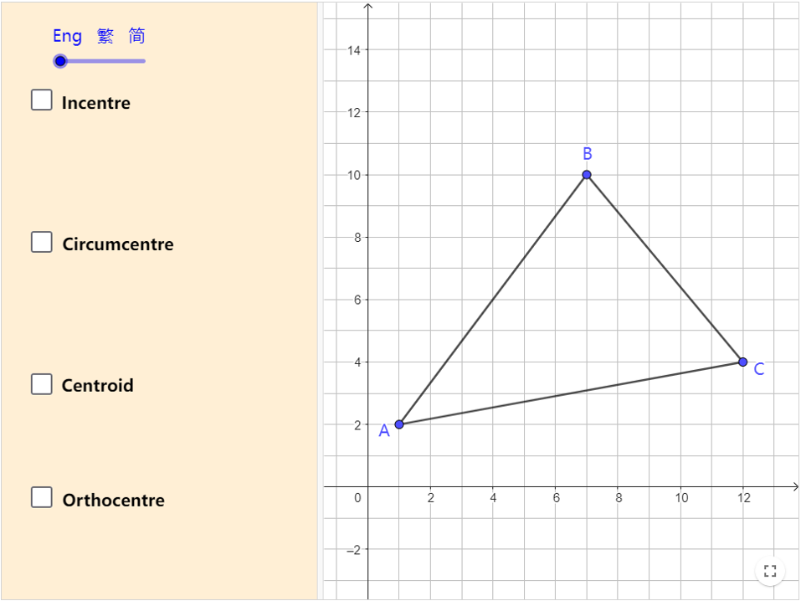
2. Which of the centres of ABC can meet our
boss’s requirement?
Use the following applet to verify your answer.
Link: https://www.geogebra.org/m/gm6ayhap

Slide 28
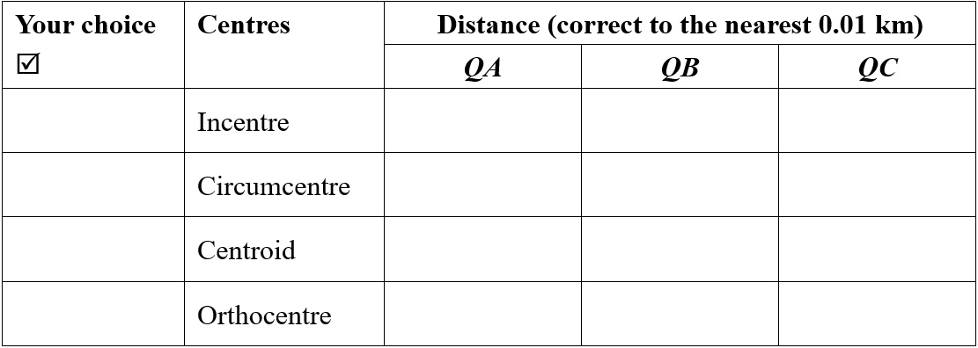
7.18
4.23
5.20
✓
5.74
5.74
5.74
6.57
4.68
5.50
8.43
2.65
5.66

Slide 29
3. What assumptions are made in your model in Question 3?
Unobstructed transmission
2D-model
There are no obstacles
(e.g., hills or buildings)
which block the transmission of the radio wave between the headquarters and the two stores.
Assuming the ground is flat.
In reality, the surface of the Earth is not flat.
If the distances between the headquarters and the two stores are very long, we have to consider the curvature of the Earth’s surface.

Slide 30
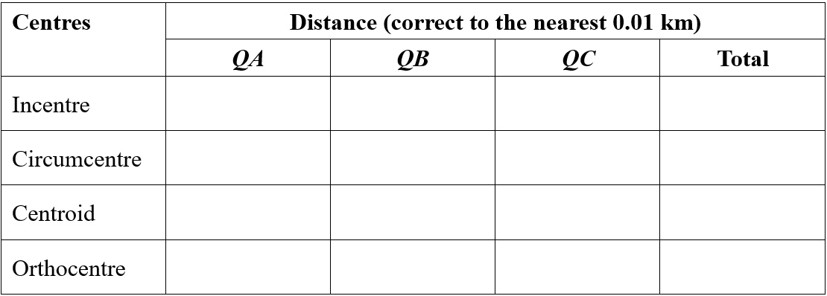
4. Can the selected location minimise the total distance
from our headquarters to the three stores?
You can use the following table to help explain your
answer.
7.18
4.23
5.20
16.61
5.74
5.74
5.74
17.22
6.57
4.68
5.50
16.75
8.43
2.65
5.66
16.74

Slide 31
7.18
4.23
5.20
16.61
5.74
5.74
5.74
17.22
6.57
4.68
5.50
16.75
8.43
2.65
5.66
16.74
The selected location（the circumcentre of ABC ）cannot minimise the total distance from Q to A, B and C. As shown in the above Table, the distance (circumcentre: 17.22 km) is greater than the three other locations, including the incentre (16.61 km), centroid (16.75 km) and orthocentre (16.74 km) of ABC .

Slide 32
Activity 2B
To ensure that the warehouse is equidistant from three roads

Slide 33
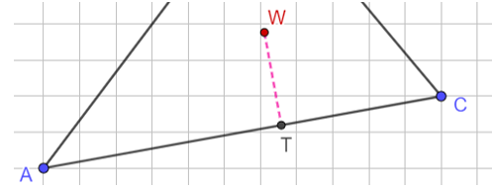
5. Between the three stores A, B and C, there are three
distributor roads that form ABC. Our boss is searching
for a location to build our warehouse W and then construct
paths from W to each distributor road.
There are two requirements regarding the selected location:
i. W must be equidistant from each of the three
distributor roads AB , BC and AC.
ii. To minimise travelling time, the paths from W to
each of the three distributor roads must be the
shortest.
In the following example, describe the geometrical relationship between road AC and path WT.

Slide 34
In the following example, describe the geometrical relationship between road AC and path WT.
WT ⊥ AC（or WT is perpendicular to AC.)

Slide 35
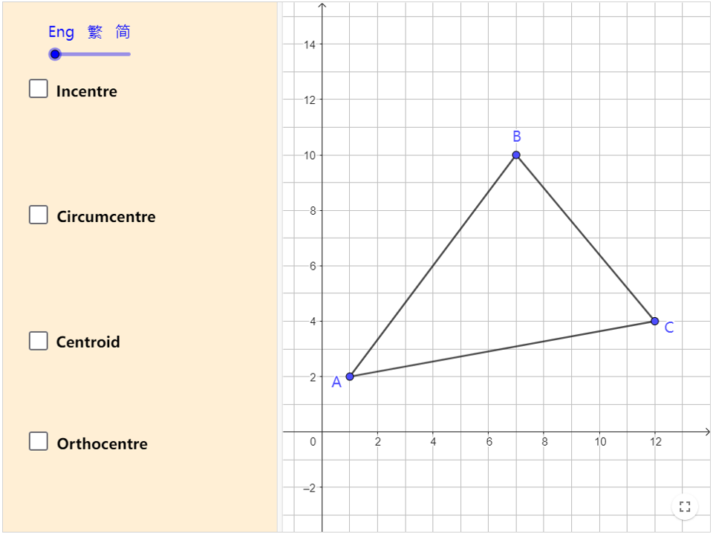
6. Which of the centres of ABC can meet our boss’s
requirement?
Use the following applet to verify your answer.
Link: https://www.geogebra.org/m/bgpwnvje

Slide 36
✓
2.62
2.62
2.62
2.83
4.21
1.32
2.53
3.24
2.27
1.94
1.30
4.15

Slide 37
Activity 2C
Enrichment Activity
To minimise total distance between the warehouse and the three stores

Slide 38
7. To better connect with the rapid transit system, an engineer
suggests locating the warehouse W beside a distributor road.
Nevertheless, the total distance between W and our three
stores A, B and C must be minimised.
Explore using the following applet: https://www.geogebra.org/m/gxtnz4cu

Slide 39
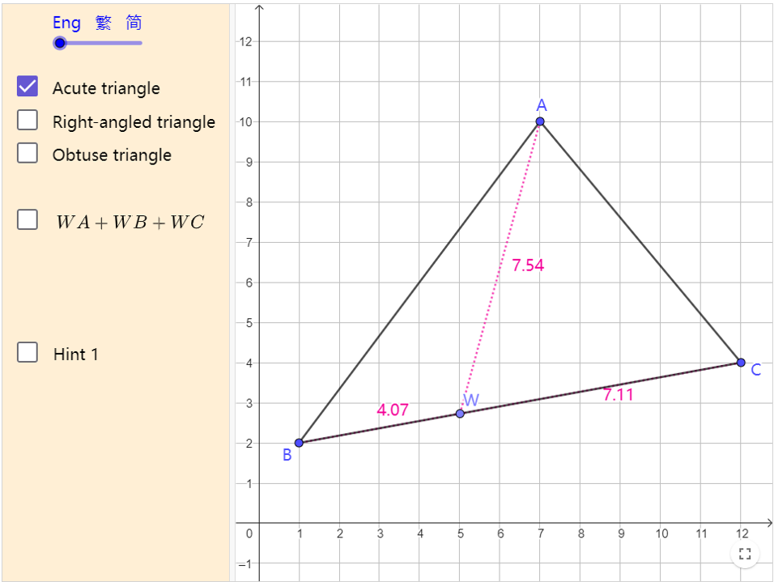
Explore using the following applet: https://www.geogebra.org/m/gxtnz4cu
Sketch and describe how to find the location of the warehouse W.
Hint: You will need to consider three different cases. It may be easier to start with the case in which ABC is a right-angled triangle.

Slide 40
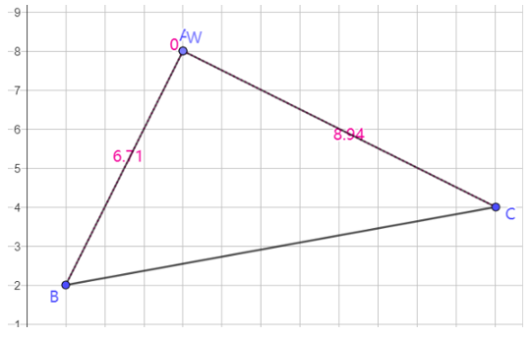
Case I：
Right-angled triangle
W is located at the vertex formed by the two shorter sides of the triangle.

Slide 41
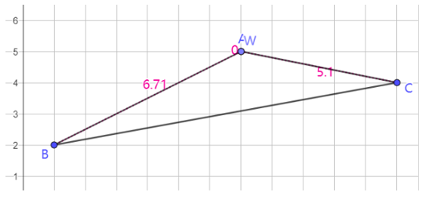
Case II：
Obtuse triangle
W is located at the vertex formed by the two shorter sides of the triangle.

Slide 42
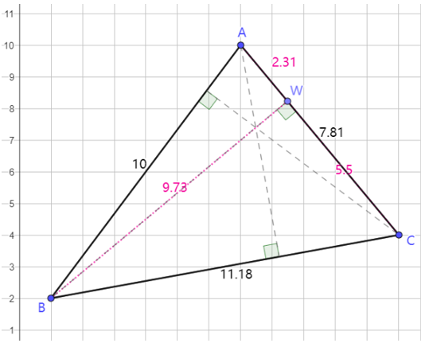
Case III：
Acute triangle
W is located at the foot of a perpendicular on the shortest side (from its corresponding vertex) of the triangle.

Slide 43
Activity 3
To use information technology in modelling

Slide 44
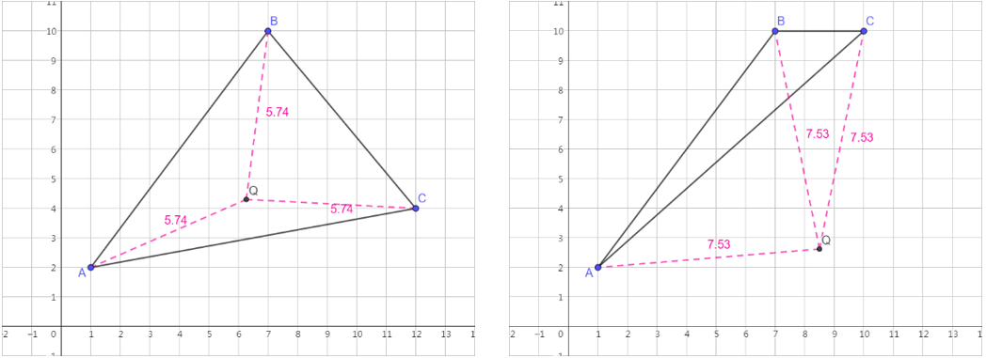
1. We can use GeoGebra to create a virtual model. It will be useful for presenting our modelling outcomes, such as the following.

Slide 45
If we build our headquarters Q at the circumcentre of ABC, then QA = QB = QC. But we found that when ABC is an obtuse triangle, Q lies outside the triangle.

Slide 46
Go to GeoGebra official website: https://www.geogebra.org/classic
We can set the language of GeoGebra:
 |  | Main manual (top right-hand corner)
 |  | Settings / 設定 / 设置 → Select your preferred language

Slide 47
Tips
In GeoGebra, after using a tool, it is a good practice to select “Move” tool.
You can understand this practice as:

Slide 48
2. The following steps will guide us through locating
our headquarters Q between stores A and B in activity 1A.
i.e., the mid-point of A and B.

Slide 49
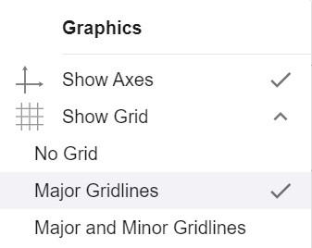
Step i
i. Set the gridlines
Right-click on the graphics view
“Show Grid” → Tick “Major Gridlines”

Slide 50
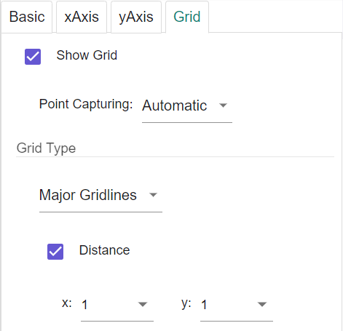
Step ii
ii. Set the distance of the grid
Right-click on the graphics view
Click “Graphics”
Go to “Grid” tab →“Grid Type” → Select “Major Gridlines”
Tick “Distance”
Set x = 1 and y = 1

Slide 51
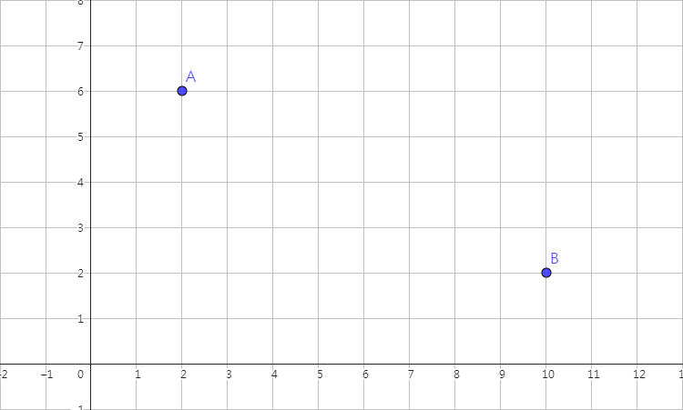
Step iii
iii. Locate the stores
Use “Point” tool to draw Points A(2, 6) and B(10, 2) or anywhere that you want

Slide 52
Step iv
iv. Locate the headquarters
Use “Midpoint or Center” tool to locate our headquarters → Select Point A → Select Point B
Right-click the midpoint →“Rename” → Input “Q”

Slide 53
Step v
v. Show the distance of QA and QB
Use “Segment” tool to draw Line segment QA
Right-click QA → “Settings” →“Basic” tab → “Show Label” → Select “Value”
Similar steps for QB

Slide 54
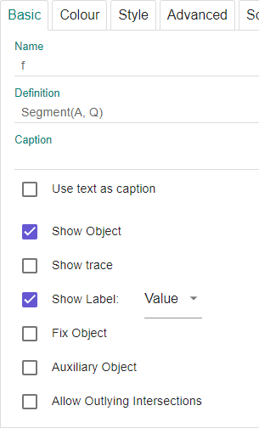
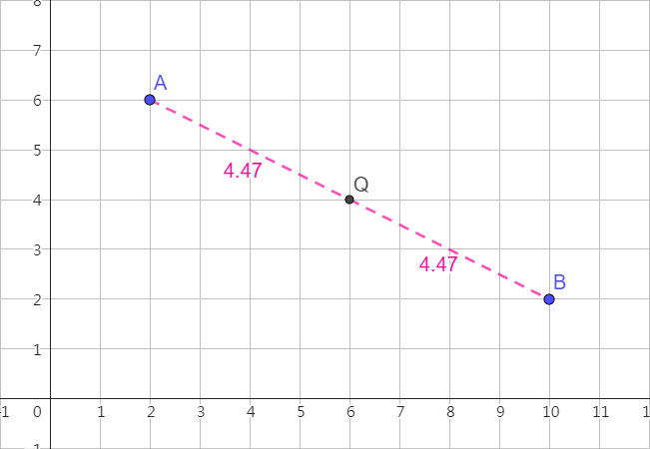
Step v
Note: You can move points A and B to observe the changes of point Q.

Slide 55
Step vi
vi. Set the colour and line style of QA and QB
Select QA → Click “Style Bar” (top-right corner) → “Set colour” and “Set line style”
Similar steps for QB

Slide 56
3. The following steps will guide us through locating
our headquarters Q among stores A, B and C in activity 2A.
i.e., the circumcentre of ABC.

Slide 57
Step i
i. Set the gridlines
Right-click on the graphics view
“Show Grid” → Tick “Major Gridlines”

Slide 58
Step i
i. Set the distance of the grid
Right-click on the graphics view
Click “Graphics”
Go to “Grid” tab →“Grid Type” → Select “Major Gridlines”
Tick “Distance”
Set x = 1 and y = 1

Slide 59
Step ii
ii. Locate the stores
Use “Point” tool to draw Points A(1, 2), B(7, 10) and C(12, 4) or anywhere that you want

Slide 60
Step iii
iii. Construct the distributor roads
Use “Segment” tool to draw Line segments AB, BC and AC

Slide 61
Step iv
iv. Draw perpendicular bisectors of each side of the triangle
Use “Perpendicular Bisector” tool to draw the perpendicular bisector of AB → Select Point A → Select Point B
Similar steps for BC and AC

Slide 62
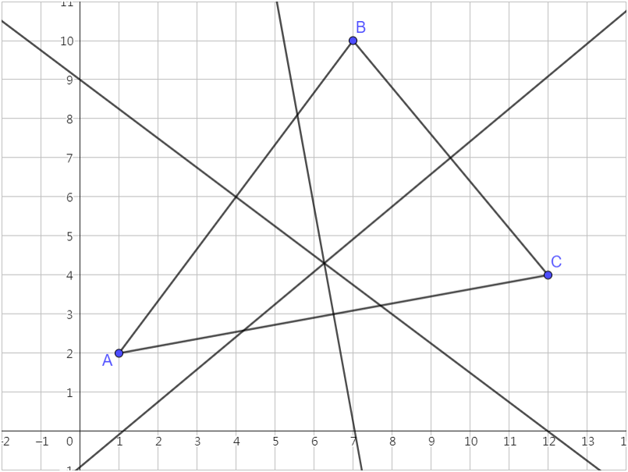

Slide 63
Step v
v. Locate the headquarters
Use “Point” tool to draw the point of intersection of the three perpendicular bisectors
Right-click the point of intersection → “Rename”→ Input “Q”

Slide 64
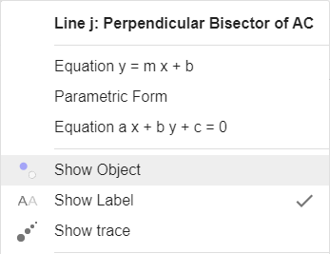
Step vi
vi. Hide the construction lines (i.e., the perpendicular bisectors)
Right-click each perpendicular bisector → Untick “Show Object”

Slide 65
Step vii
vii. Show the distance of QA，QB and QC
Use “Segment” tool to draw Line segment QA
Right-click QA → “Settings” → “Basic” tab → “Show Label” → Select “Value”
Set the colour and line style of QA
Similar steps for QB and QC

Slide 66
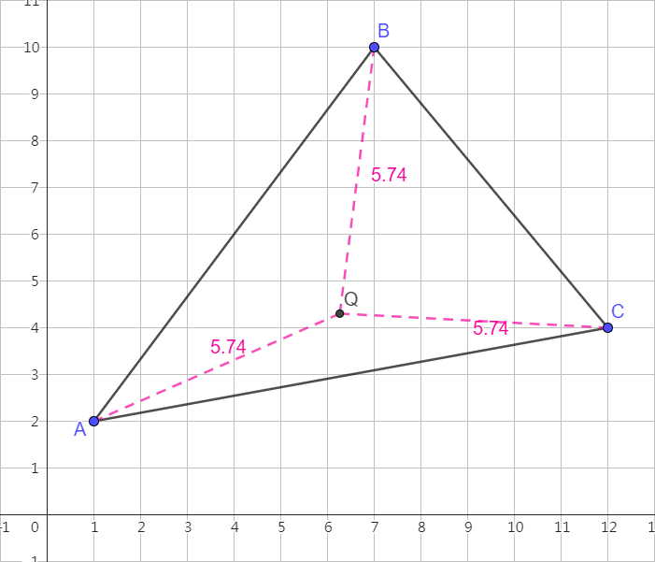
Note: You can move points A, B and C to observe the changes of point Q.

Slide 67
4. The following steps will guide us through locating
our headquarters W among stores A, B and C in activity 2B.
i.e., the incentre of ABC.

Slide 68
Step i
i. Set the gridlines
Right-click on the graphics view
“Show Grid” → Tick “Major Gridlines”

Slide 69
Step i
i. Set the distance of the grid
Right-click on the graphics view
Click “Graphics”
Go to “Grid” tab →“Grid Type” → Select “Major Gridlines”
Tick “Distance”
Set x = 1 and y = 1

Slide 70
Step ii
ii. Locate the stores
Use “Point” tool to draw Points A(1, 2), B(7, 10) and C(12, 4) or anywhere that you want

Slide 71
Step iii
iii. Construct the distributor roads
Use “Segment” tool to draw Line segments AB, BC and AC

Slide 72
Step iv
iv. Draw angle bisectors of each angle of the triangle
Use “Angle Bisector” tool to draw the angle bisector of ∠BAC → Select Point B → Select Point A → Select Point C
Similar steps for ∠ABC and ∠ACB

Slide 73
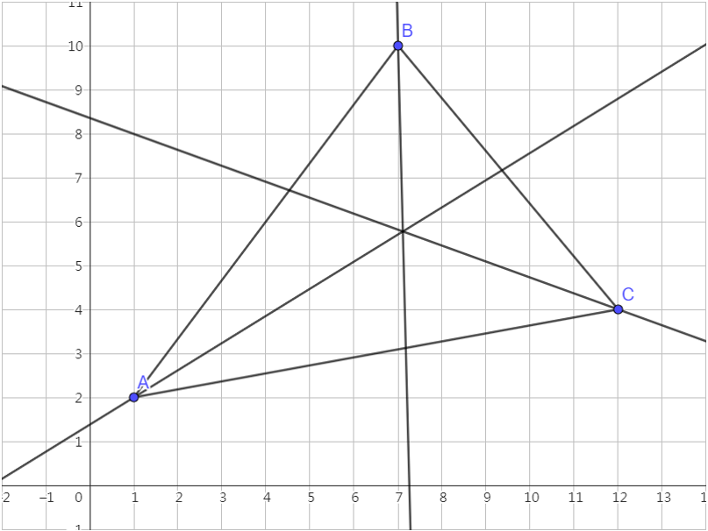

Slide 74
Step v
v. Locate the warehouse
Use “Point” tool to draw the point of intersection of the three angle bisectors
Right-click the point →“Rename” → Input “W”

Slide 75
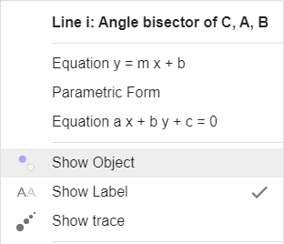
Step vi
vi. Hide the construction lines
(i.e., the angle bisectors)
Right-click each angle bisector → Untick “Show Object”

Slide 76
Step vii
vii. Draw the foot of a perpendicular from W on each side of the triangle
Use “Perpendicular Line” tool → Select Point W → Select AB
Use “Point” tool to create the point of intersection
Similar steps for BC and AC
Rename the points as in the figure

Slide 77
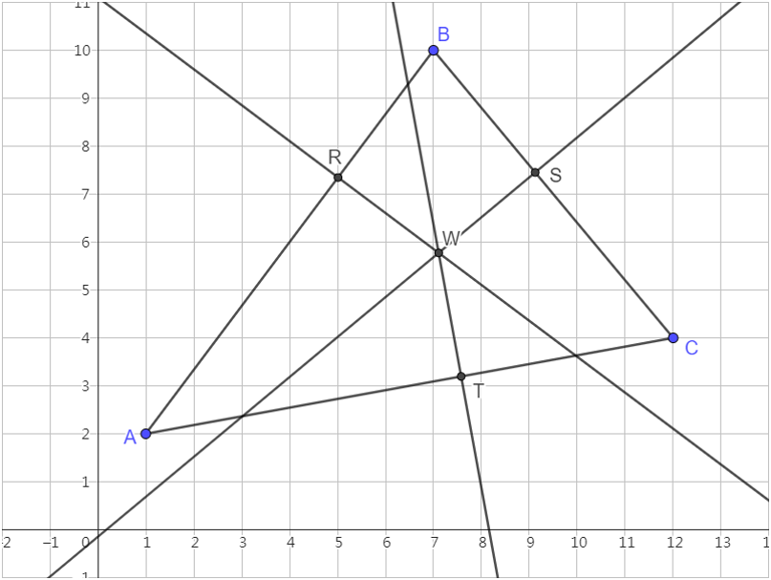

Slide 78
Step viii
viii. Hide the construction lines
(i.e., the perpendicular line)
Right-click each perpendicular line → Untick “Show Object”

Slide 79
Step ix
ix. Show the distance of WR, WS and WT
Use “Segment” tool to draw Line segment WR
Right-click WR → “Settings” → “Basic” tab → “Show Label” → Select “Value”
Set the colour and line style of WR
Similar steps for WS and WT

Slide 80
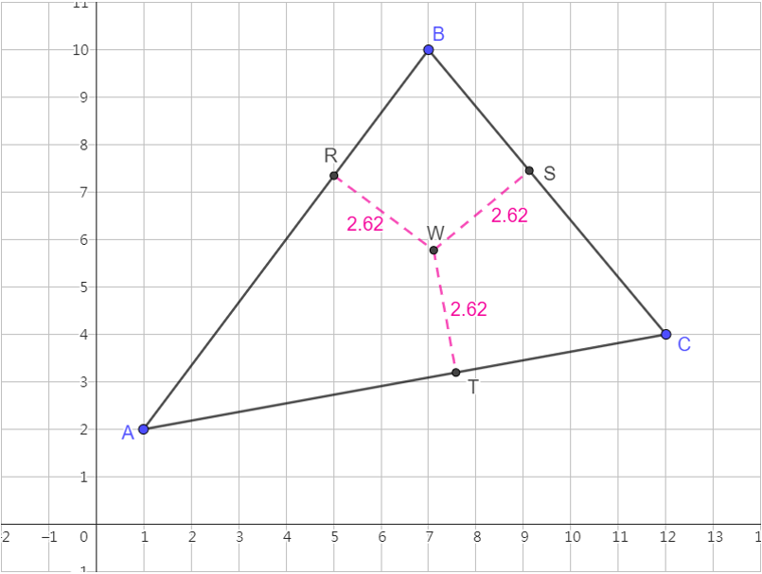
Note: You can move points A, B and C to observe the changes of point W.

